Slide 1
ENGI 301 Morse Code Transceiver Proposal
02/19/2024
Edwin Low

Slide 2
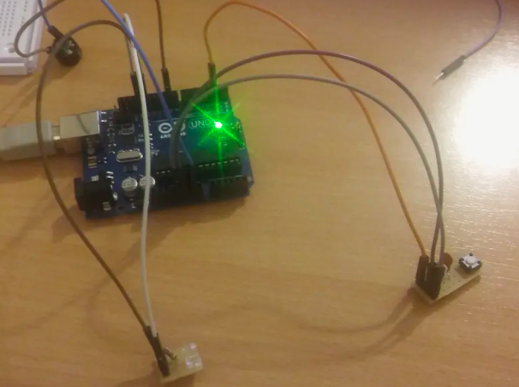
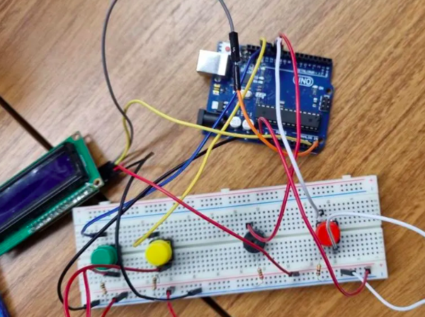
Background Information
Story: I’ve always wanted to have a good excuse to learn the Morse code. It’s cool to have a secret way of communicating with someone else. Morse code is now pretty much a thing of the past, and it’s good that almost no one understands it now. However, this project is not aimed at teaching how to use the Morse code; instead, it focuses more on taking the user’s Morse code input, displaying the message on a screen, and, if the message is correct, sending it to a phone as a text message. If possible, the user can also input a text message from a phone and send that message back to the PocketBeagle, where the message will be displayed. The project’s goal is to familiarize myself with Morse code through a series of practice transmission instead of merely trying to memorize the whole alphabet.
https://www.hackster.io/vladakrsmanovic/arduino-morse-code-machine-709cc5
https://www.hackster.io/brzi/morse-code-machine-72a63f
https://www.hackster.io/492608/morse-code-converter-bec9a9
https://www.hackster.io/achindra/morse-code-transceiver-b5ae38
https://github.com/Tooo/Morse-Code-Driver-BeagleBone/blob/main/morse-code.c
(1st three websites are basic Morse code machines where users press a button to enter morse code, LED lights up, buzzer buzzes, and display shows the letters entered. 4th website allows for transceiving between two Arduinos. Last website contains BeagleBone code for a Morse code machine.)

Slide 3
More Background
Most projects online only allow users to input Morse code (press button, LED and buzzer responds to inputs, screen displays letters). Some more advanced projects allow for transmission of the message between two Arduino boards. My project will improve the user interface. There should be 5 buttons: one for starting/stopping input, one for entering letters, one for indicating spaces between letters/words (a conventional morse code machine uses pauses for separating letters and words, but as a beginner with no experience in Morse code, these pauses may not be long enough), one for deleting characters, one for transmitting the message. LEDs and buzzers will still be there when the user inputs the message. There will also be an SPI screen to display the dots and dashes and the letters entered. After the message is displayed, the user can check for errors, and if it is fine, the user can transmit the message to a phone. The phone receives the message in text.
This past ENGI 301 project has code on how to send text message to phone: https://www.hackster.io/fernandalago/plant-reminder-box-473f95. I can perhaps modify the code so that the phone can send a message back to the PocketBeagle via text. The screen displays the message received (in both text and dots and dashes), and the LEDs and buzzer also respond in Morse code.

Slide 4
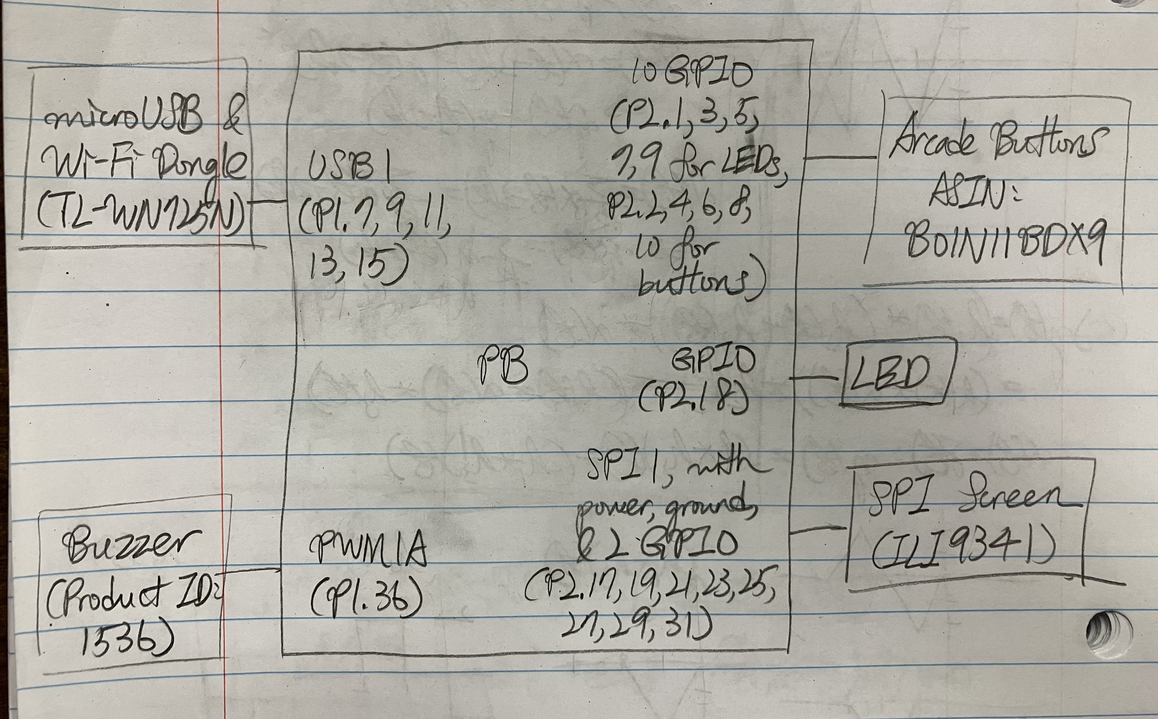
System Block Diagram

Slide 5
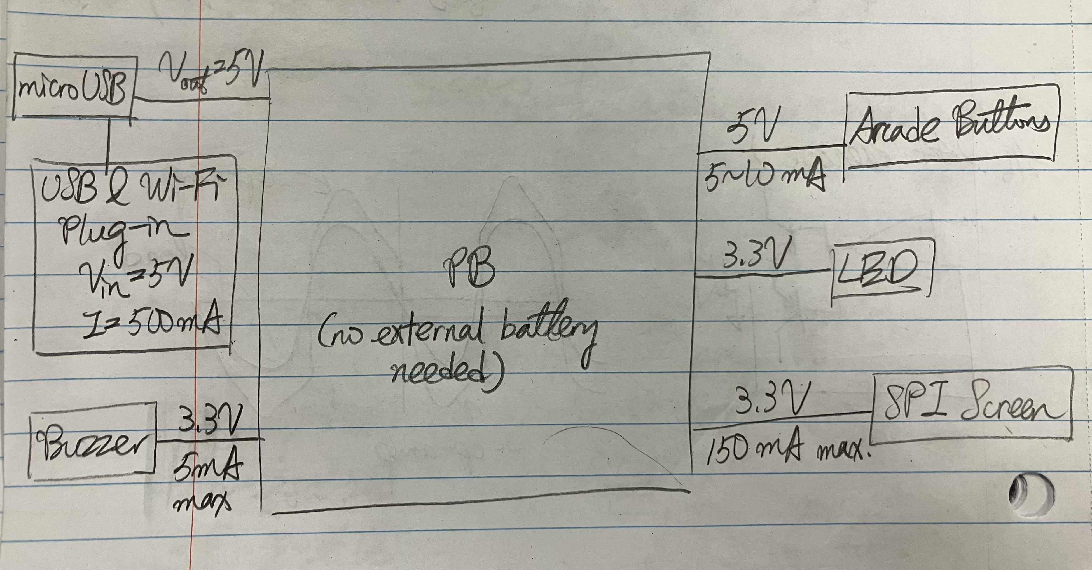
Power Block Diagram

Slide 6
Components / Budget
Component | ENGI301 to Buy? | Cost
Arcade Buttons * 5 (may replace some buttons with push buttons already in the ENGI 301 case if budget isn’t enough) | Yes | $11.88
SPI Screen | Yes | $29.95
Buzzer | Yes | $0.95
LEDs | No
USB Wifi: https://www.amazon.com/wifi-adapter-usb-pc-network/dp/B008IFXQFU | Yes | $9.99
microUSB Breakout Board: https://www.mouser.com/ProductDetail/SparkFun/BOB-12035?qs=WyAARYrbSna977XdJQqmwA%3D%3D&mgh=1&srsltid=AfmBOop8pqnpRJ7OGa4kUyn1-4g_jDgPRdfFHH1MvHX90ayUqfos1SPHRyg | Yes | $2.75

